Slide 2
Overview
Part 1 – Gate Circuits and Boolean Equations
  Binary Logic and Gates
  Boolean Algebra
  Standard Forms
Part 2 – Circuit Optimization
  Two-Level Optimization
  Map Manipulation
  Practical Optimization (Espresso)
  Multi-Level Circuit Optimization
Part 3 – Additional Gates and Circuits
  Other Gate Types
  Exclusive-OR Operator and Gates
  High-Impedance Outputs
Chapter 2 - Part 2 <number>

Slide 3
Circuit Optimization
Goal: To obtain the simplest implementation for a given function
Optimization is a more formal approach to simplification that is performed using a specific procedure or algorithm
Optimization requires a cost criterion to measure the simplicity of a circuit
Distinct cost criteria we will use:
  Literal cost (L)
  Gate input cost (G)
  Gate input cost with NOTs (GN)
Chapter 2 - Part 2 <number>

Slide 4
Literal Cost
Literal – a variable or it complement
Literal cost – the number of literal appearances in a Boolean expression corresponding to the logic circuit diagram
Examples:
  F = BD + A C + A L = 8
  F = BD + A C + A + AB L =
  F = (A + B)(A + D)(B + C + )( + + D) L =
  Which solution is best?
B
C
D
D
C
B
B
D
B
C
Chapter 2 - Part 2 <number>
Notes:
2nd Literal Cost = 11
3rd Literal Cost = 10
The first solution is best

Slide 5
Gate Input Cost
Gate input costs - the number of inputs to the gates in the implementation corresponding exactly to the given equation or equations. (G - inverters not counted, GN - inverters counted)
For SOP and POS equations, it can be found from the equation(s) by finding the sum of:
  all literal appearances
  the number of terms excluding single literal terms,(G) and
  optionally, the number of distinct complemented single literals (GN).
Example:
  F = BD + A C + A G = 8, GN = 11
  F = BD + A C + A + AB G = , GN =
  F = (A + )(A + D)(B + C + )( + + D) G = , GN =
  Which solution is best?
B
C
D
B
B
D
C
B
D
B
C
Chapter 2 - Part 2 <number>
Notes:
G = 15, GN = 18 (second value includes inverter inputs)
G = 14, GN = 17
1st solution is best

Slide 6
Cost Criteria (continued)
GN = G + 2 = 9
Example 1:
F = A + B C +
L = 5
C
B
G = L + 2 = 7
B
C
A
F
L (literal count) counts the AND inputs and the single
literal OR input.
G (gate input count) adds the remaining OR gate inputs
GN(gate input count with NOTs) adds the inverter inputs
Chapter 2 - Part 2 <number>

Slide 7
Cost Criteria (continued)
A
Example 2:
F = A B C +
L = 6 G = 8 GN = 11
F = (A + )( + C)( + B)
L = 6 G = 9 GN = 12
Same function and same
literal cost
But first circuit has better
gate input count and better
gate input count with NOTs
Select it!
B
C
B
A
C
F
C
B
A
A
B
C
F
Chapter 2 - Part 2 <number>

Slide 8
Boolean Function Optimization
Minimizing the gate input (or literal) cost of a (a set of) Boolean equation(s) reduces circuit cost.
We choose gate input cost.
Boolean Algebra and graphical techniques are tools to minimize cost criteria values.
Some important questions:
  When do we stop trying to reduce the cost?
  Do we know when we have a minimum cost?
Treat optimum or near-optimum cost functions
for two-level (SOP and POS) circuits first.
Introduce a graphical technique using Karnaugh maps (K-maps, for short)
Chapter 2 - Part 2 <number>

Slide 9
Karnaugh Maps (K-map)
A K-map is a collection of squares
  Each square represents a minterm
  The collection of squares is a graphical representation of a Boolean function
  Adjacent squares differ in the value of one variable
  Alternative algebraic expressions for the same function are derived by recognizing patterns of squares
The K-map can be viewed as
  A reorganized version of the truth table
  A topologically-warped Venn diagram as used to visualize sets in algebra of sets
Chapter 2 - Part 2 <number>

Slide 10
Some Uses of K-Maps
Provide a means for:
  Finding optimum or near optimum
    SOP and POS standard forms, and
    two-level AND/OR and OR/AND circuit implementations
  for functions with small numbers of variables
  Visualizing concepts related to manipulating Boolean expressions, and
  Demonstrating concepts used by computer-aided design programs to simplify large circuits
Chapter 2 - Part 2 <number>

Slide 11
Two Variable Maps
A 2-variable Karnaugh Map:
  Note that minterm m0 and
  minterm m1 are “adjacent”
  and differ in the value of the
  variable y
  Similarly, minterm m0 and
  minterm m2 differ in the x variable.
  Also, m1 and m3 differ in the x variable as well.
  Finally, m2 and m3 differ in the value of the variable y
y = 0
y = 1
m
₀ =
m
₁ =
x = 0
x
y
x
y
x = 1
m
₂ =
m
₃ =
x
y
x
y
Chapter 2 - Part 2 <number>

Slide 12
K-Map and Truth Tables
The K-Map is just a different form of the truth table.
Example – Two variable function:
  We choose a,b,c and d from the set {0,1} to implement a particular function, F(x,y).
Function Table
K-Map
Input
Function
Values
Value
y = 0
y = 1
(x,y)
F(x,y)
x = 0
a
b
0 0
a
0 1
b
x = 1
c
d
1 0
c
1 1
d
Chapter 2 - Part 2 <number>

Slide 13
K-Map Function Representation
Example: F(x,y) = x
For function F(x,y), the two adjacent cells containing 1’s can be combined using the Minimization Theorem:
F = x
y = 0
y = 1
x = 0
0
0
x = 1
1
1
F
(
x
,
y
)
=
x
y
+
x
y
=
x
Chapter 2 - Part 2 <number>

Slide 14
K-Map Function Representation
Example: G(x,y) = x + y
For G(x,y), two pairs of adjacent cells containing 1’s can be combined using the Minimization Theorem:
G = x+y
y = 0
y = 1
x = 0
0
1
x = 1
1
1
(
)
(
)
G
(
x
,
y
)
=
x
y
+
x
y
+
xy
+
x
y
=
x
+
y
Duplicate x y
Chapter 2 - Part 2 <number>

Slide 15
Three Variable Maps
A three-variable K-map:
Where each minterm corresponds to the product terms:
Note that if the binary value for an index differs in one bit position, the minterms are adjacent on the K-Map
yz=00
yz=01
yz=11
yz=10
x=0
m₀
m₁
m₃
m₂
x=1
m₄
m₅
m₇
m₆
yz=00
yz=01
yz=11
yz=10
x=0
x
y
z
x
y
z
x
y
z
x
y
z
x=1
x
y
z
x
y
z
x
y
z
x
y
z
Chapter 2 - Part 2 <number>

Slide 16
Alternative Map Labeling
Map use largely involves:
  Entering values into the map, and
  Reading off product terms from the map.
Alternate labelings are useful:
y
y z
y
y
x
00
01
11
10
x
0
1
3
2
0
0
1
3
2
x
4
5
7
6
x
1
4
5
7
6
z
z
z
z
Chapter 2 - Part 2 <number>

Slide 17


Example Functions
By convention, we represent the minterms of F by a "1" in the map and leave the minterms of blank
Example:
Example:
Learn the locations of the 8
indices based on the variable
order shown (x, most significant
and z, least significant) on the
map boundaries
F
y
0
3
1
1
1
2
x
4
7
6
1
5
1
z
y
0
1
3
2
1
x
4
7
1
5
1
6
1
z
Chapter 2 - Part 2 <number>

Slide 18
Combining Squares
By combining squares, we reduce number of literals in a product term, reducing the literal cost, thereby reducing the other two cost criteria
On a 3-variable K-Map:
  One square represents a minterm with three variables
  Two adjacent squares represent a product term with two variables
  Four “adjacent” terms represent a product term with one variable
  Eight “adjacent” terms is the function of all ones (no variables) = 1.
Chapter 2 - Part 2 <number>

Slide 19

Example: Combining Squares
y
Example: Let
Applying the Minimization Theorem three times:
Thus the four terms that form a 2 × 2 square correspond to the term "y".
0
3
2
1
1
1
x
4
5
7
6
1
1
z
F
(
x
,
y
,
z
)
=
x
y
z
+
x
y
z
+
x
y
z
+
x
y
z
=
yz
+
y
z
=
y
Chapter 2 - Part 2 <number>

Slide 20
Three-Variable Maps
Reduced literal product terms for SOP standard forms correspond to rectangles on K-maps containing cell counts that are powers of 2.
Rectangles of 2 cells represent 2 adjacent minterms; of 4 cells represent 4 minterms that form a “pairwise adjacent” ring.
Rectangles can contain non-adjacent cells as illustrated by the “pairwise adjacent” ring above.
Chapter 2 - Part 2 <number>

Slide 21
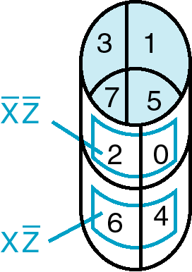
Three-Variable Maps
Topological warps of 3-variable K-maps that show all adjacencies:
  Venn Diagram  Cylinder
0
X
4
6
5
7
Y
3
Z
2
1
Chapter 2 - Part 2 <number>

Slide 22
Three-Variable Maps
Example Shapes of 2-cell Rectangles:
Read off the product terms for the rectangles shown
y
0
1
3
2
x
4
5
7
6
z
Chapter 2 - Part 2 <number>

Slide 23
Three-Variable Maps
Example Shapes of 4-cell Rectangles:
Read off the product terms for the rectangles shown
y
0
1
3
2
x
4
5
7
6
z
Chapter 2 - Part 2 <number>

Slide 24

Three Variable Maps
K-Maps can be used to simplify Boolean functions by
systematic methods. Terms are selected to cover the
“1s”in the map.
Example: Simplify
z
x
y
y
1
1
1
x
1
1
z
F(x,
y,
z)
=
z
+
x
y
Chapter 2 - Part 2 <number>

Slide 25
Three-Variable Map Simplification
Use a K-map to find an optimum SOP equation for
Chapter 2 - Part 2 <number>
Notes:
F = Z’ + X’ Y’ + X Y

Slide 26
Four Variable Maps
Map and location of minterms:
Y
0
1
3
2
4
5
7
6
12
15
14
X
Variable Order
13
W
8
9
11
10
Z
Chapter 2 - Part 2 <number>

Slide 27
Four Variable Terms
Four variable maps can have rectangles corresponding to:
  A single 1 = 4 variables, (i.e. Minterm)
  Two 1s = 3 variables,
  Four 1s = 2 variables
  Eight 1s = 1 variable,
  Sixteen 1s = zero variables (i.e.
  Constant "1")
Chapter 2 - Part 2 <number>

Slide 28
Four-Variable Maps
Example Shapes of Rectangles:
Y
0
1
3
2
4
5
7
6
12
13
15
14
X
W
8
9
11
10
Z
Chapter 2 - Part 2 <number>

Slide 29
Four-Variable Maps
Example Shapes of Rectangles:
Y
0
1
3
2
4
5
7
6
X
12
13
15
14
W
8
9
11
10
Z
Chapter 2 - Part 2 <number>

Slide 30
Four-Variable Map Simplification
F(W,
X,
Y,
Z)
=
Σ
(0,
2,4,5,6,7,
8,10,13,15
)
m
Chapter 2 - Part 2 <number>
Notes:
F = XZ + X'Z'

Slide 31
Four-Variable Map Simplification
F(W,
X,
Y,
Z)
=
Σ
(3,4,5,7,9,1
3,14,15
)
m
Chapter 2 - Part 2 <number>
Notes:
F = W' X Y' + W' Y Z + WXY + WY'Z

Slide 32
Systematic Simplification
A Prime Implicant is a product term obtained by combining the maximum possible number of adjacent squares in the map into a rectangle with the number of squares a power of 2.
A prime implicant is called an Essential Prime Implicant if it is the only prime implicant that covers (includes) one or more minterms.
Prime Implicants and Essential Prime Implicants can be determined by inspection of a K-Map.
A set of prime implicants "covers all minterms" if, for each minterm of the function, at least one prime implicant in the set of prime implicants includes the minterm.
Chapter 2 - Part 2 <number>

Slide 33
Example of Prime Implicants
Find ALL Prime Implicants
CD
ESSENTIAL Prime Implicants
C
C
B
D
B
D
1
1
1
1
1
1
BD
1
1
BD
1
1
B
B
1
1
1
1
A
A
1
1
1
1
1
1
1
1
A
B
D
D
AD
Minterms covered by single prime implicant
B
C
Chapter 2 - Part 2 <number>

Slide 34
Prime Implicant Practice
Find all prime implicants for:
Chapter 2 - Part 2 <number>
Notes:
Prime implicants are: A, B'C, and B'D'

Slide 35
Another Example
Find all prime implicants for:
  Hint: There are seven prime implicants!
Chapter 2 - Part 2 <number>
Notes:
Prime Implicants are AB, B C' D', A' C' D', A' B' D', A' B' C, A' C D, B C D.

Slide 36
Five Variable or More K-Maps
For five variable problems, we use two adjacent K-maps. It becomes harder to visualize adjacent minterms for selecting PIs. You can extend the problem to six variables by using four K-Maps.
V = 0
V = 1
Y
Y
X
X
W
W
Z
Z
Chapter 2 - Part 2 <number>

Slide 37
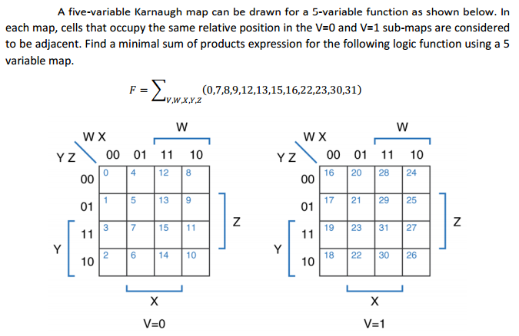
Chapter 2 - Part 2 <number>

Slide 38

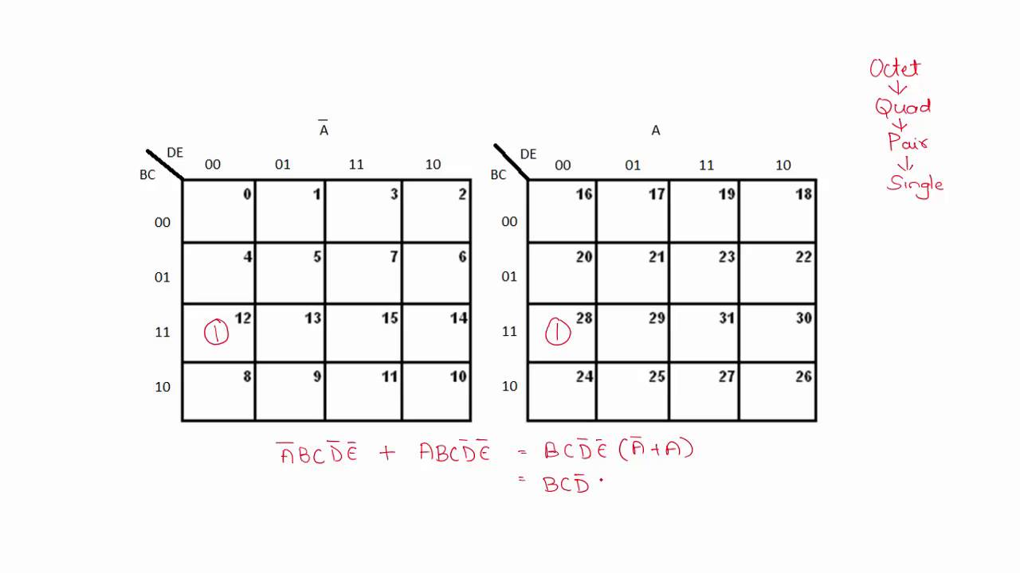
Chapter 2 - Part 2 <number>

Slide 39
Don't Cares in K-Maps
Sometimes a function table or map contains entries for which it is known:
  the input values for the minterm will never occur, or
  The output value for the minterm is not used
In these cases, the output value need not be defined
Instead, the output value is defined as a “don't care”
By placing “don't cares” ( an “x” entry) in the function table or map, the cost of the logic circuit may be lowered.
Example 1: A logic function having the binary codes for the BCD digits as its inputs. Only the codes for 0 through 9 are used. The six codes, 1010 through 1111 never occur, so the output values for these codes are “x” to represent “don’t cares.”
Chapter 2 - Part 2 <number>

Slide 40
Don't Cares in K-Maps
Example 2: A circuit that represents a very common situation that occurs in computer design has two distinct sets of input variables:
  A, B, and C which take on all possible combinations, and
  Y which takes on values 0 or 1.
and a single output Z. The circuit that receives the output Z observes it only for combinations of A, B, and C such A = 1 and B = 1 or C = 0, otherwise ignoring it. Thus, Z is specified only for those combinations, and for all other combinations of A, B, and C, Z is a don’t care. Specifically, Z must be specified for AB + C = 1, and is a don’t care for :
AB + C = (A + B)C = AC + BC = 1
Ultimately, each don’t care “x” entry may take on either a 0 or 1 value in resulting solutions
For example, an “x” may take on value “0” in an SOP solution and value “1” in a POS solution, or vice-versa.
Any minterm with value “x” need not be covered by a prime implicant.
Chapter 2 - Part 2 <number>

Slide 41
Example: BCD “5 or More”
The map below gives a function F1(w,x,y,z) which is defined as "5 or more" over BCD inputs. With the don't cares used for the 6 non-BCD combinations:
        F1 (w,x,y,z) = w + x z + x y G = 7
        This is much lower in cost than F2 where the “don't cares” were treated as "0s."
        G = 12
        For this particular function, cost G for the POS solution for F₁(w,x,y,z) is not changed by using the don't cares.
y
0
0
0
0
0
1
3
2
0
1
1
1
4
5
7
6
x
X
X
X
X
F₂(w,
x,
y,
z)
=
w
x
z
+
w
x
y
+
w
x
y
w
12
13
15
14
1
1
X
X
8
9
11
10
z
Chapter 2 - Part 2 <number>

Slide 42

Product of Sums Example
Find the optimum POS solution:
  Hint: Use and complement it to get the result.
F
Chapter 2 - Part 2 <number>
Notes:
F' = B' D' + A' B
F = (B + D)(A + B')

Slide 43
Optimization Algorithm
Find all prime implicants.
Include all essential prime implicants in the solution
Select a minimum cost set of non-essential prime implicants to cover all minterms not yet covered:
  Obtaining an optimum solution: See Reading Supplement - More on Optimization
  Obtaining a good simplified solution: Use the Selection Rule
Chapter 2 - Part 2 <number>

Slide 44
Prime Implicant Selection Rule
Minimize the overlap among prime implicants as much as possible. In particular, in the final solution, make sure that each prime implicant selected includes at least one minterm not included in any other prime implicant selected.
Chapter 2 - Part 2 <number>

Slide 45
Selection Rule Example
Simplify F(A, B, C, D) given on the K-map.
Selected
Essential
C
C
1
1
1
1
1
1
1
1
1
1
1
1
1
B
B
1
1
A
A
1
1
1
1
D
D
Minterms covered by essential prime implicants
Chapter 2 - Part 2 <number>

Slide 46
Selection Rule Example with Don't Cares
Simplify F(A, B, C, D) given on the K-map.
Selected
Essential
C
C
1
x
1
x
1
x
x
1
1
x
x
1
B
B
x
x
A
A
1
1
x
1
1
x
D
D
Minterms covered by essential prime implicants
Chapter 2 - Part 2 <number>

